Slide 1


Project Management Review
ParaDocs
Team E - Surgical Robot for Orthopedics

Slide 2
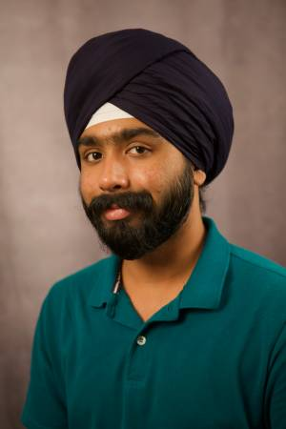
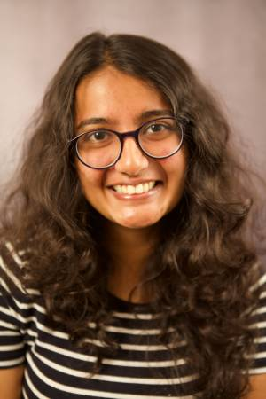
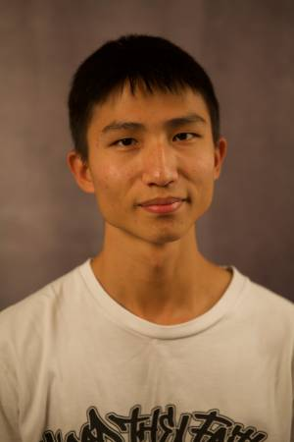
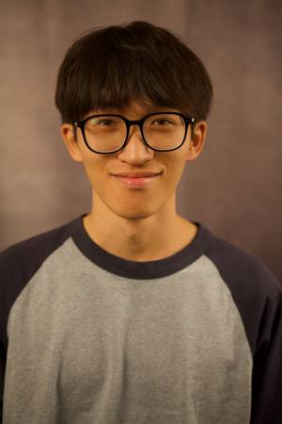
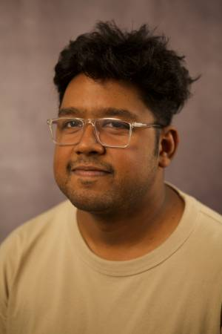
The ParaDocs are
Paramjit
Shivangi
Li-Wei
Kimi
Abhishek
With Branko, Parker, Sundaram, Kaushik

Slide 3
1
Overview

Slide 4
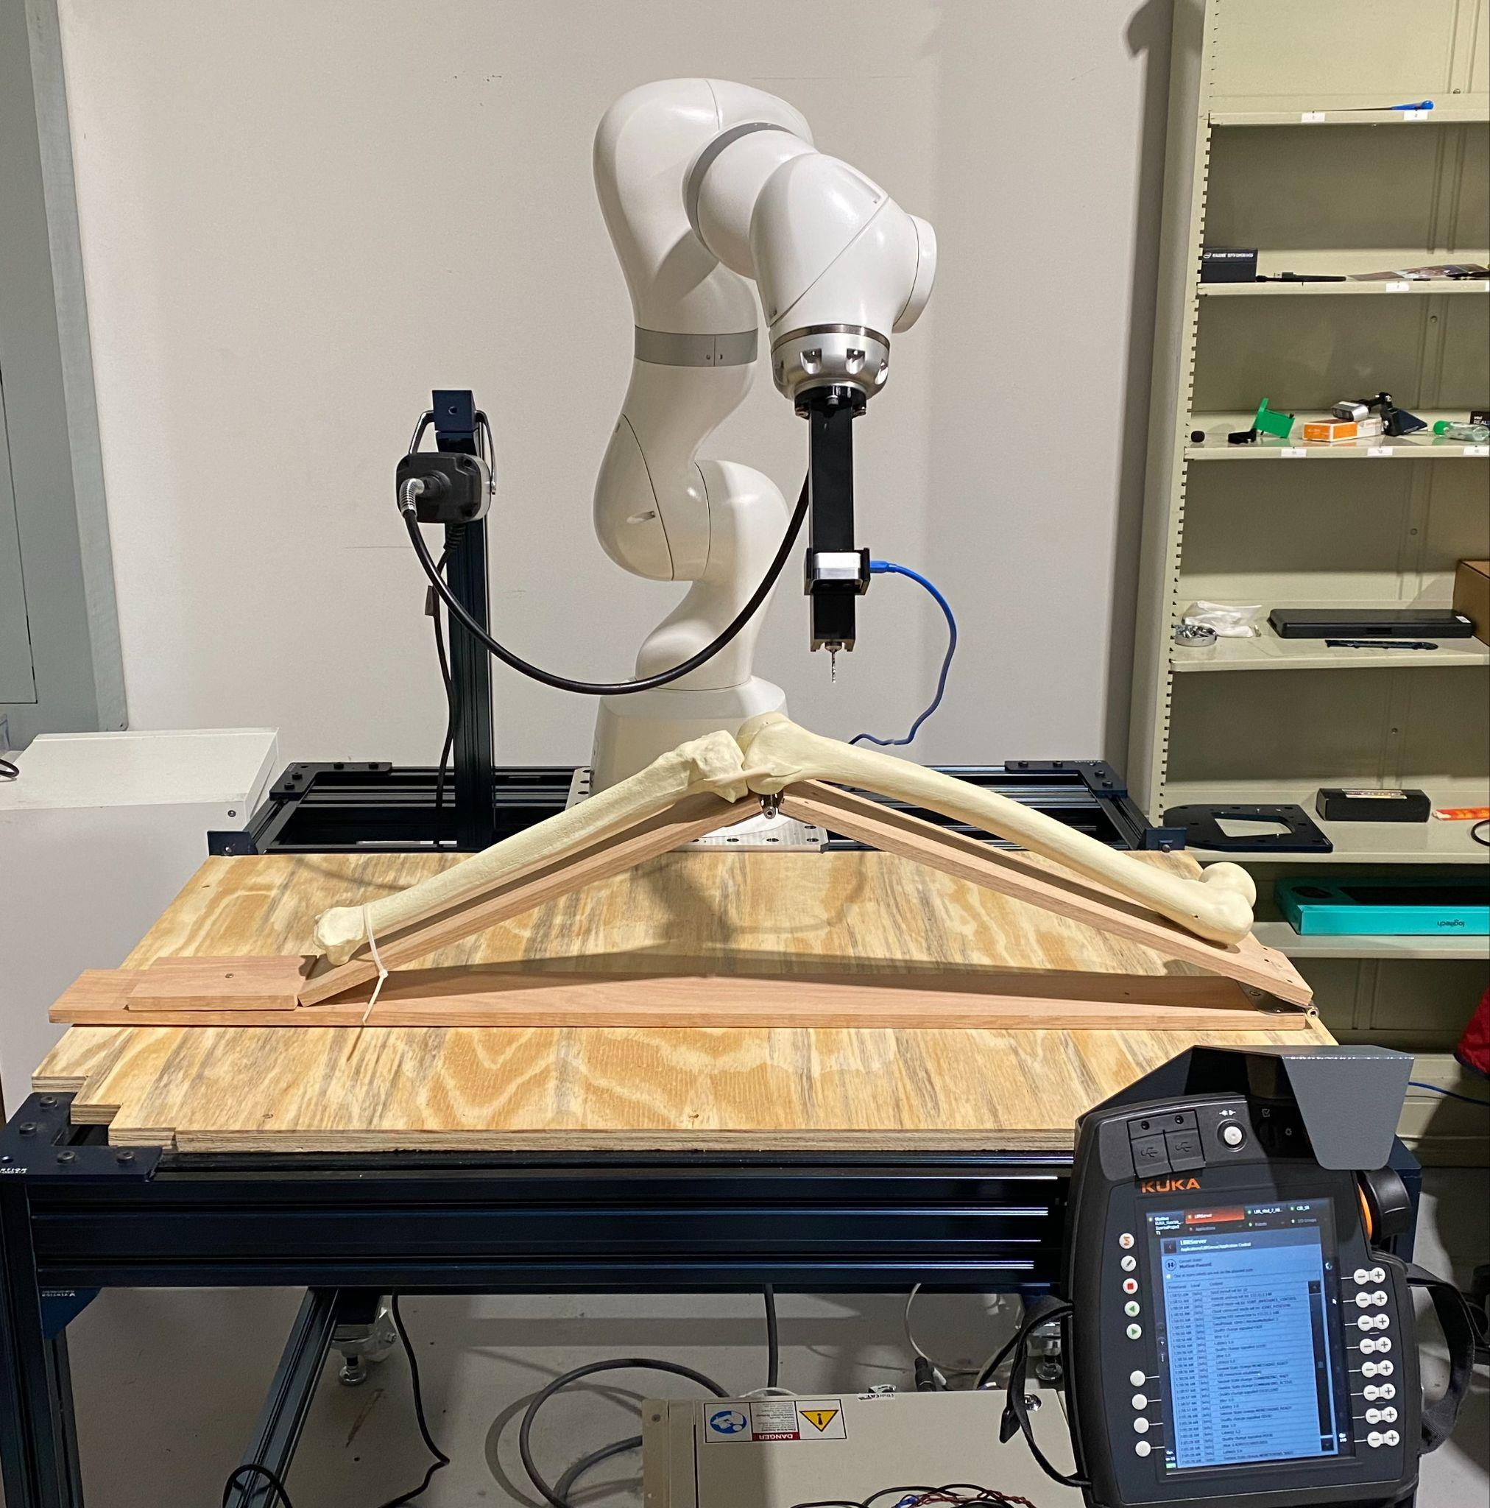
The Project
Aim: To precisely and robustly register the drilling site, navigate to site and drill holes sufficient to slide in a surgical pin
Autonomous
Non-Invasive
Robust

Slide 5
The Project
System to assist in Total Knee Replacement Surgery
Key Components
KUKA LBR Manipulator
RealSense D405 Camera
Dremel 9100 Drill
General Workflow
Register (Where is the bone located in the scene)
Plan (A collision free path for the end effector)
Drill (Make hole(s) at designated spots)
Notes:
Explain the definition of words

Slide 6
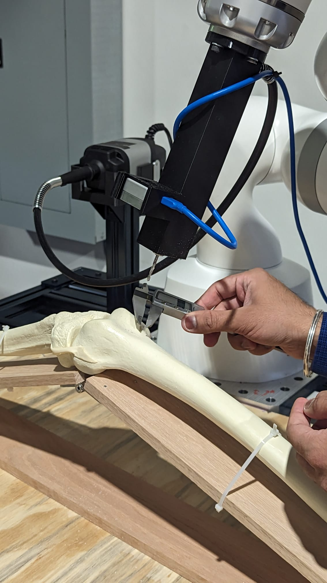
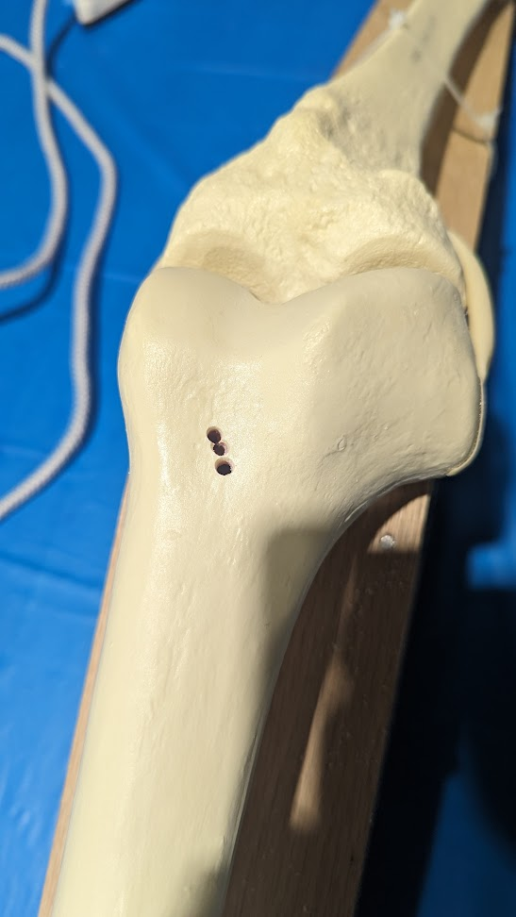
SVD Runs (April 18 2024)
Spring Validation Demo | April 18
Trial | Result | Error Approx
1 | S | <= 4mm
2 | S | <= 4mm
3 | Connection Err | -
4 | S | <= 4mm
ParaDocs

Slide 7
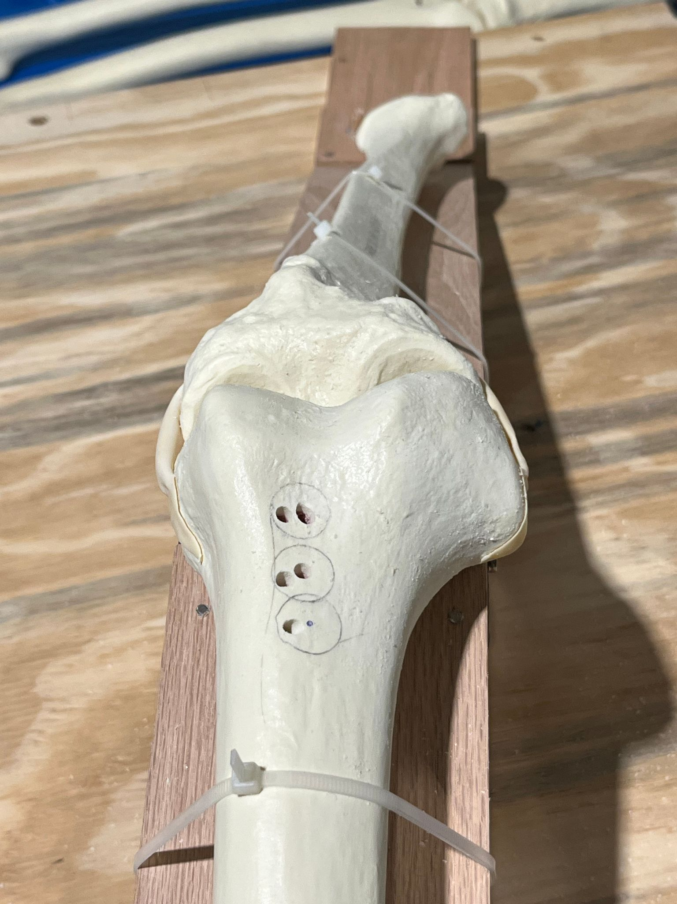
SVD Encore Runs (April 18 2024)
Encore| April 25
Trial | Result | Error Approx
1 | S | <= 2mm
2 | Third Hole Failed | First two holes <=2mm
3 | S | All holes within 8mm
ParaDocs

Slide 8
2
Tech

Slide 9

General Approach
Last semester, our primary goal was to get an end-to-end drilling system in place.
In pursuit of this, we decided to ignore certain features not immediately relevant to the core functionality, such as UI / Motion Compensation.
While our core subsystems are functional and can get the job done, we believe there is still room for improvement and optimization, which will be reflected in our subsystem progress updates.
Notes:
Explain the definition of words

Slide 10
Subsystem Progress
[ Hardware ] [ 85 %]
End-Effector Iteration
Bone Mount Improvements
[ Perception ] [ 65 %]
Integrate SAM Pipeline with Manipulation Stack
Tibia Registration
Develop functionality to track/re-register at frequent intervals
Performance optimizations
Update planning scene with obstacles
Notes:
Explain the definition of words

Slide 11
Subsystem Progress
[ Manipulation ] [ 40 %]
Planning
Guarantee Optimal Paths
Plan around obstacles within the scene
Incorporate a Behavior Tree / FSM
Control
OCS2 based control for motion compensation
[ Surgeon UI ] [ 0 %]
Need interface for surgeons to see system status and give commands if necessary
Still in design phase. Finalizing Reqs + Tech Stack
Notes:
Explain the definition of words

Slide 12
Key Challenges and Associated Plans
No. | Subsystem | Challenge | Plan
1 | Perception | Registration doesn’t perfectly align 100% of the time | Integrate and test SAM Pipeline. Essentially leverage semantic information.
2 | Perception | Registration requires many priors ( Such as Femur always to the left ) | Incorporate UI and get surgeon input to designate Femur
3 | Perception | Registration is slow. (It's good enough for one-time registration but not fast enough for continuous registration) | Optimize overall perception pipeline. A lot of it is native Python code and not parallelized.
4 | Planning | Planner is slow and doesn’t always give optimal paths. | Most of our efforts this semester will be towards building the planning stack from the ground up. At least 3/5 members will be working on this.
5 | Overall | Complicated and delicate ROS2 workspace setup. Can break if a package is arbitrarily updated. | Dockerize Everything.
Notes:
Explain the definition of words

Slide 13
3
Project management

Slide 14




Overview ( Spring )
 | Discord Comms |  | Notion Meeting notes, logistics
 | Google Drive Storing documents, sheets |  | JIRA Project Management
Notes:
Explain the definition of words

Slide 15

Overview ( Fall )
 | Discord Comms |  | Notion Meeting notes, logistics
 | Google Drive Storing documents, sheets |  | Trello Project Management
Notes:
Explain the definition of words

Slide 16
Overview ( Fall )
two-week sprints align with Progress Reviews
Biweekly sponsor meeting, lasting 1 hour, alternating with Progress Reviews
Worksesh twice a week, each lasting 2 hours
Stand-up
Discussion
Collaboratively working
Card system penalty

Slide 17
Lessons & Improvements
We had retrospective meeting post-SVD/encore
What went well
Learned each other’s work style
Biweekly sponsor meeting (alternates with PR)
Helped internship hunt
Kept some personal time (didn’t meet everyday)
SVD and PR went smoothly, every last effort we pushed led great outcome
Problems -> Solution
Jira may be overkill -> Trello
No one cares about daily bot -> No daily bot anymore
Meeting Notifications -> Google Calendar Invite

Slide 18
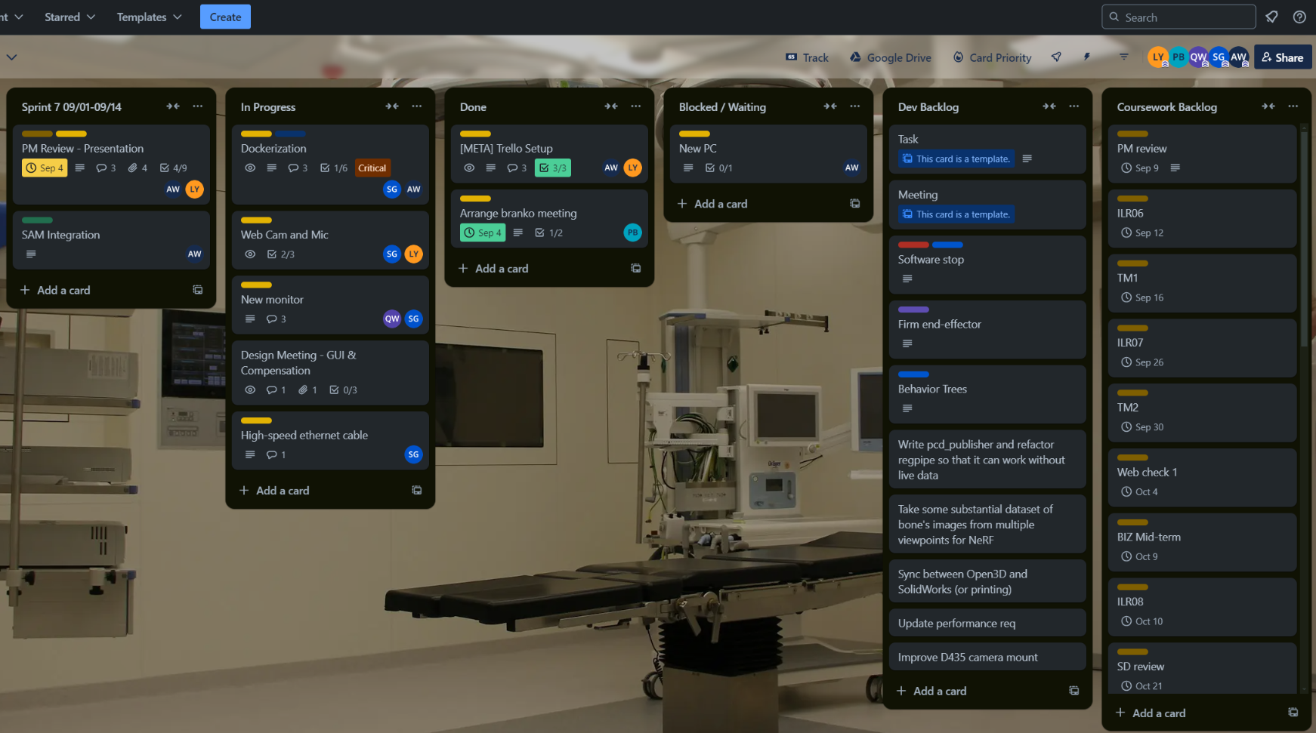
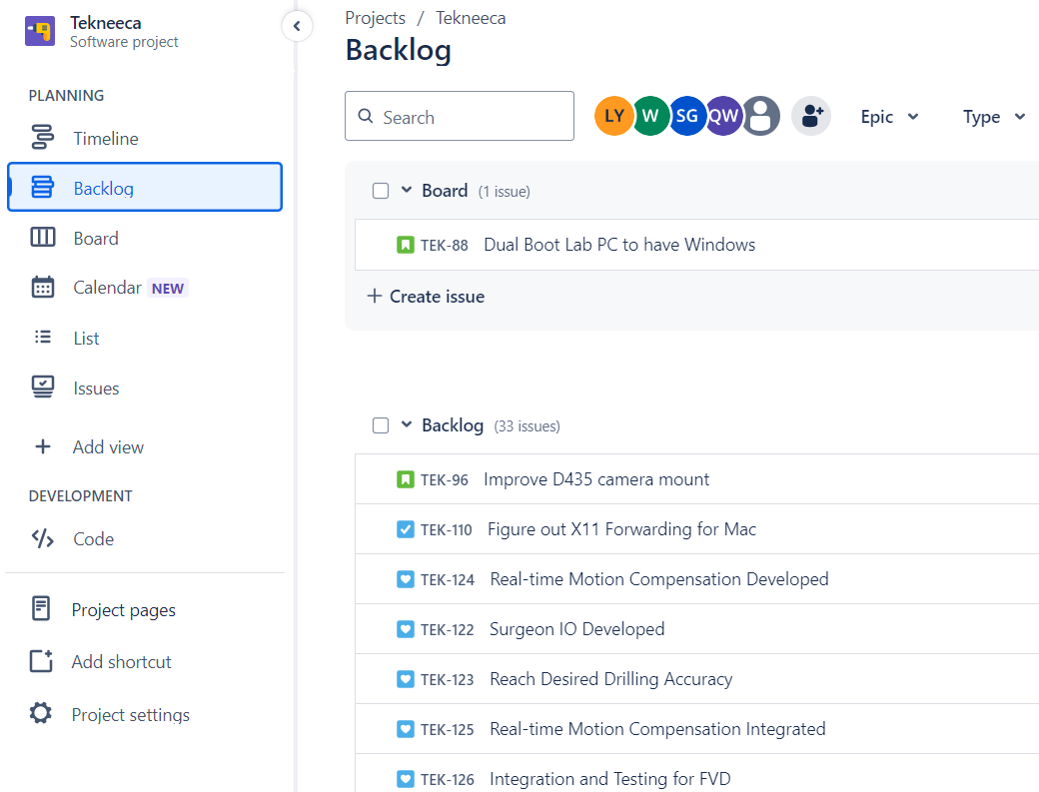

Slide 19
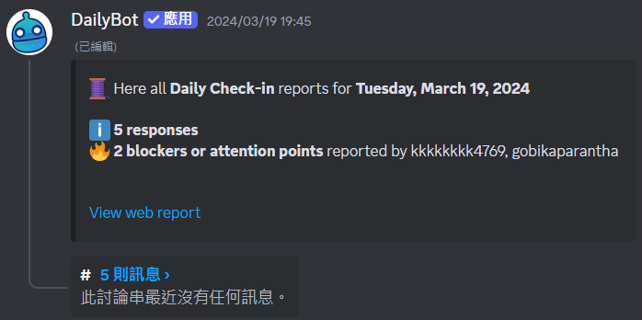
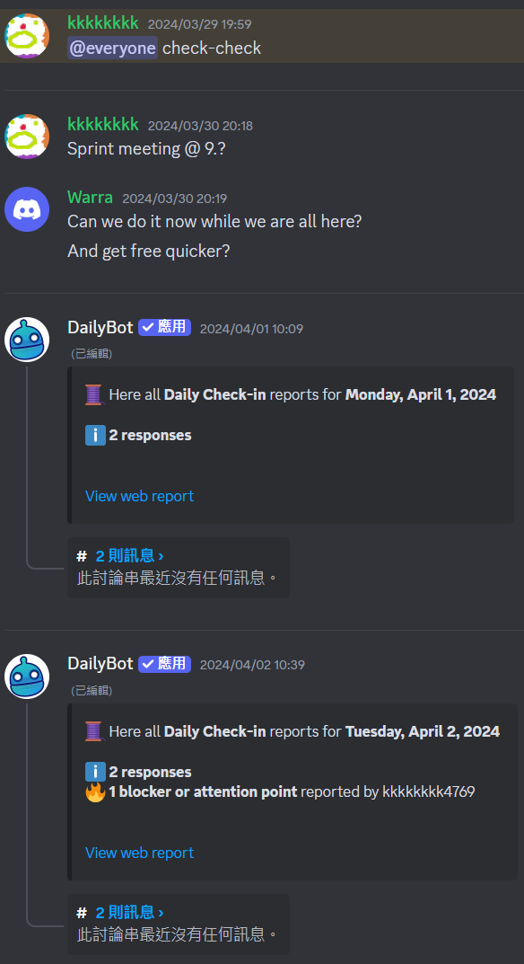
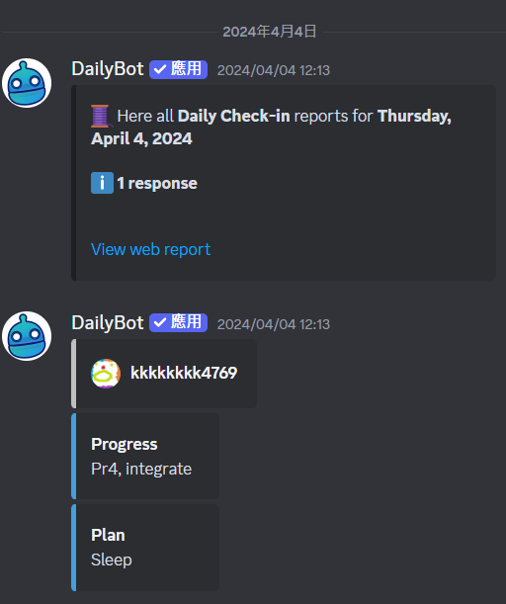
📉
We show no respect to DailyBot as time goes by

Slide 20
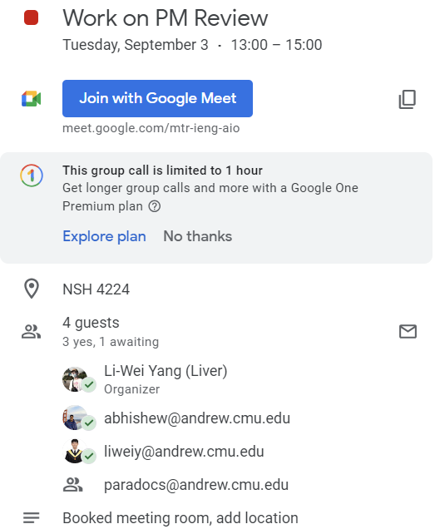
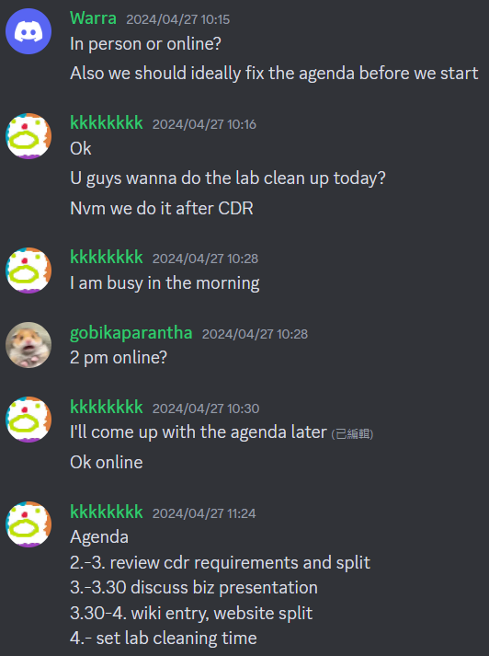
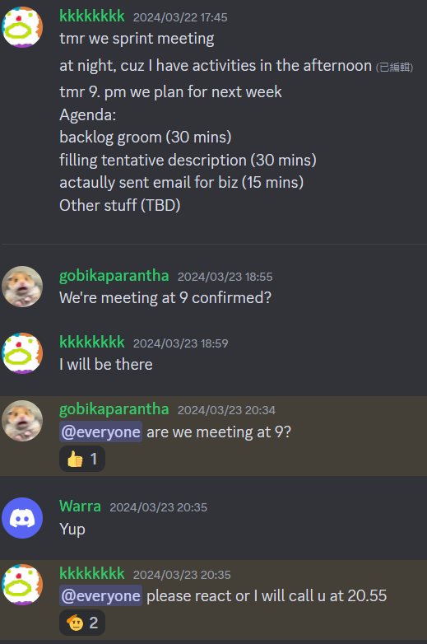

Slide 21
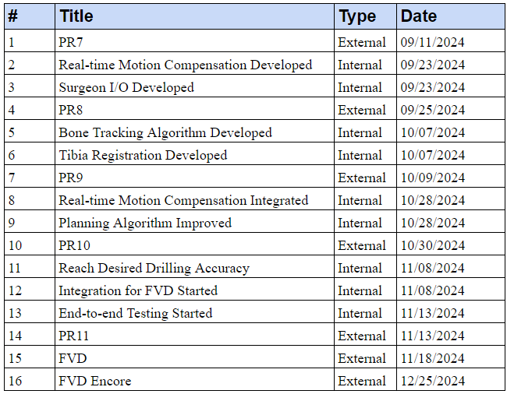
Schedule
Notes:
Improve planning algo: bone always insight and tracked using D405

Slide 22
Progress Reviews
Identifier | Date | Capabilities
PR7 | Sept. 11 | Dockerize the system Preliminary surgeon I/O functionality
PR8 | Sept. 25 | Surgeon I/O developed Real-time motion compensation developed
PR9 | Oct. 9 | Bone tracking algorithm developed Tibia registration developed Reach perception accuracy
PR10 | Oct. 30 | Planning Algorithm Improved Real-time motion compensation integrated Tibia drilling
PR11 | Nov. 13 | Reach drilling accuracy Full system demo
PR12 (FVD) | Nov. 18 | Full system demo
PR13 (FVD Encore) | Nov. 25 | Improve the system according to the feedback from FVD

Slide 23
Mitigated Risks
Risk ID | Risk | Type* | Likelihood | Consequence | Mitigation
R3 | Manipulator is damaged | T | 1 | 5 | - Follow user manual for safely operating and transporting the arm - Store arm in a secure area away from liquids, weather conditions
R5 | Drill injures a person | T | 1 | 4 | - Design and build and test our E-Stop - Follow drill user manual for safe operation - Keep people a safe distance away - Have a first-aid kit ready
R6 | A group member is absent | S | 3 | 3 | - Have a primary and secondary assignee for each task - Check member mental/physical status during stand-up meetings
R7 | Version conflicts or data loss | T | 4 | 3 | - Set up version control software (Git & GitHub) - Backed up blob on Google Drive
*T: Technical, S: Schedule
Notes:
Cut down risks

Slide 24
Active Risks
Risk ID | Risk | Type* | Likelihood | Consequence | Mitigation
R8 | Lost connection to the manipulator | T | 2 | 5 | - Keep cable taped to the ground - Modify FRI client behavior, override the state
R10 | Planning fails | T | 3 | 5 | - Replan after planning fail - Define pre-drill pose to avoid singularities
*T: Technical, S: Schedule

Slide 25
Thank You!
Questions?

